Slide 1


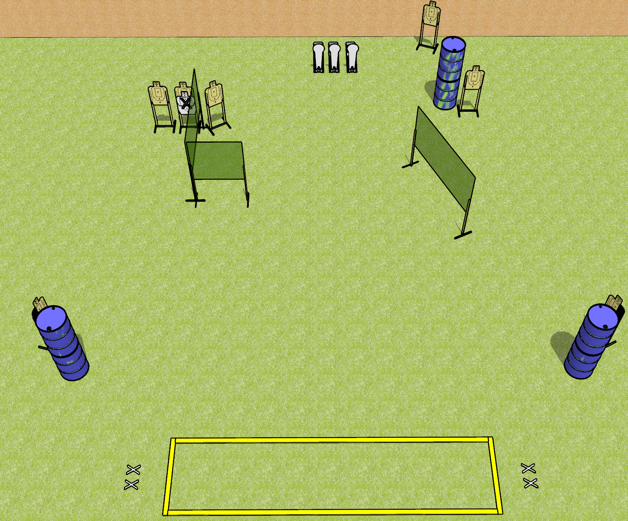
 | Dothan Gun Club – USPSA Match Hot Step Course Designer : Drew Coleman
Round Count 17 rounds 7 USPSA 3 colt poppers
Equipment List 2 medium fault lines, 4x10’ fault lines 5 wall feet 1 left and 1 right hard cover

Slide 2
Hot Step
Written Stage Briefing
Hot Step is a 17 round, 85 point, Comstock course of fire. There are 7 USPSA targets and 3 colt poppers. The best 2 hits on paper will score, and steel must fall to score. The start signal is audible.
Handgun start position is feet on either set of X’s, wrists below belt. Handgun is loaded and holstered.
PCC start position is feet on either set of X’s, stock on belt. Loaded carbine is held with both hands, safety on.
On start signal, engage targets as they become available from within the shooting area.

